Slide 1
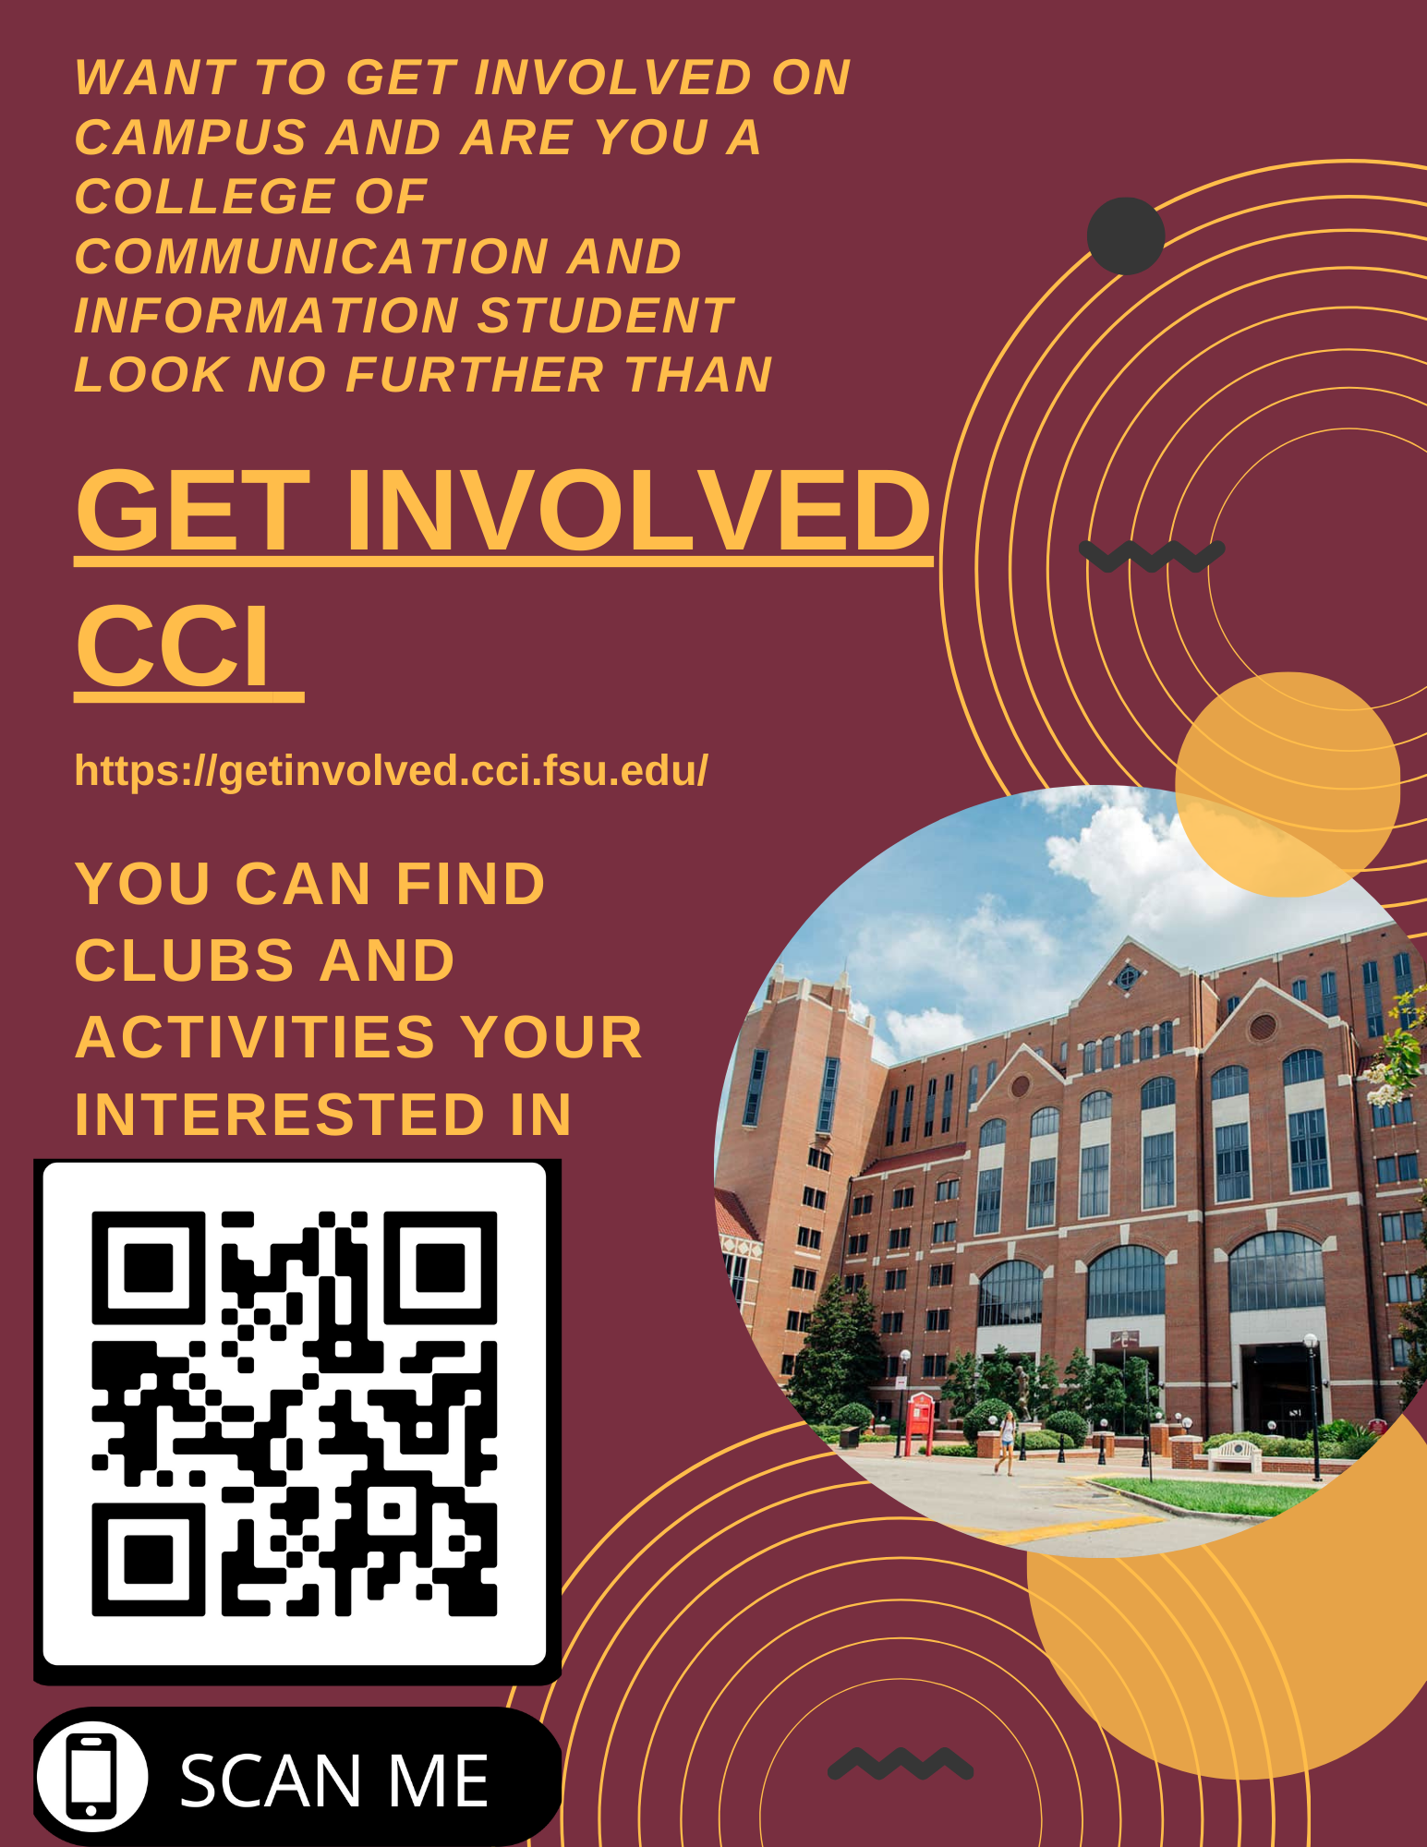
Promoting GetInvolved Co-Leader(s) Names: Justin Scinicariello, John Jimenez Members Names: Caswell King, Danny Moreno, Jamie Guterman, John Camel, Rebeckah Anestin, Stefan Alexander, William Rouse III
Picture goes HERE
Create and execute a plan to promote the GetInvolved website and promote student orgs - find ways to engage FSU CCI students and measure your impact. Make suggestions for improvement. Create a plan to promote and grow engagement by 15-20% growth

Slide 2
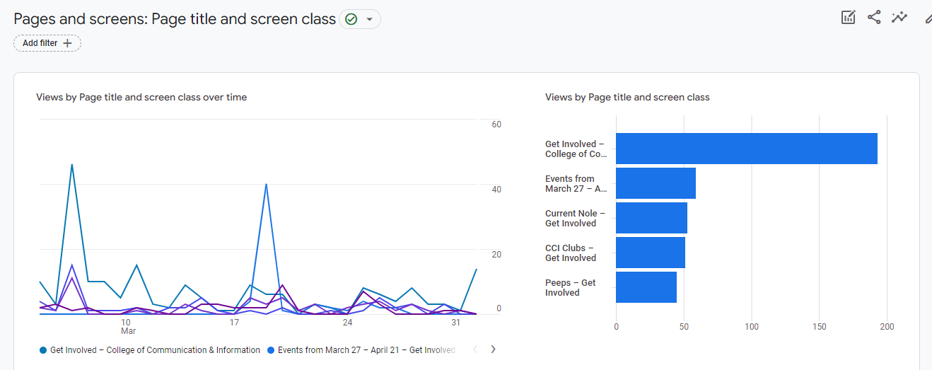
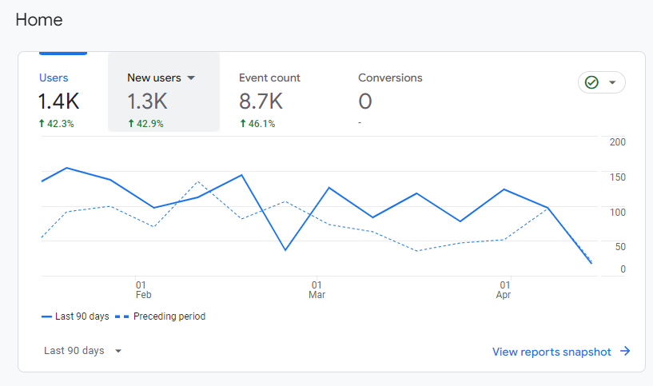
Metrics
Goals | Results | Metric
Increase traffic to the website by 15-20% | We have had increased the traffic by ~42% | Our total users count from the start of the semester went up by 43%!
Make flyers and post them throughout the School of Communications and School of Information | We posted Flyers at William johnston building, Louis shores building, CCI advising office, UCC, HCB, and THG | We exceed our metric because we posted flyers in non cci buildings like Thagard and HCB
We will reach out to Jowett to email the CCI school | We reached out to him to post the flyer in the Ischool newsletter | We met that goal by contacting him and he we also able to put us in contact with the grad school Email newsletter

Slide 3
Team Performance
Name | Role | What did they do?
Caswell King | Member | Responded to GroupMe Message for potential collaborations with other groups
Danny Moreno | Member | Made Flyer Design Suggestions
Jamie Guterman | Member | Promoted GetInvolved to other students
John Camel | Member | Gave us ideas on where to distribute flyers through campus
Rebeckah Anestin | Member | Gave us ideas on where to distribute flyers through campus
Stefan Alexander | Member | Responded to GroupMe Message for potential collaborations with other groups
William Rouse III | Member | Promoted GetInvolved to other students

Slide 4
Leader Performance
Name | Leadership Style | Strengths | Areas for Improvement | How would you grade yourself?
Justin Scinicariello | Democratic, Participative | Innovative, Consistency | Communication, Motivation | A+
Name | Leadership Style | Strengths | Areas for Improvement | How would you grade yourself?
John Jimenez | Pace-Setter | Communication,innovative | Time Management,Consistency | A+

Slide 5
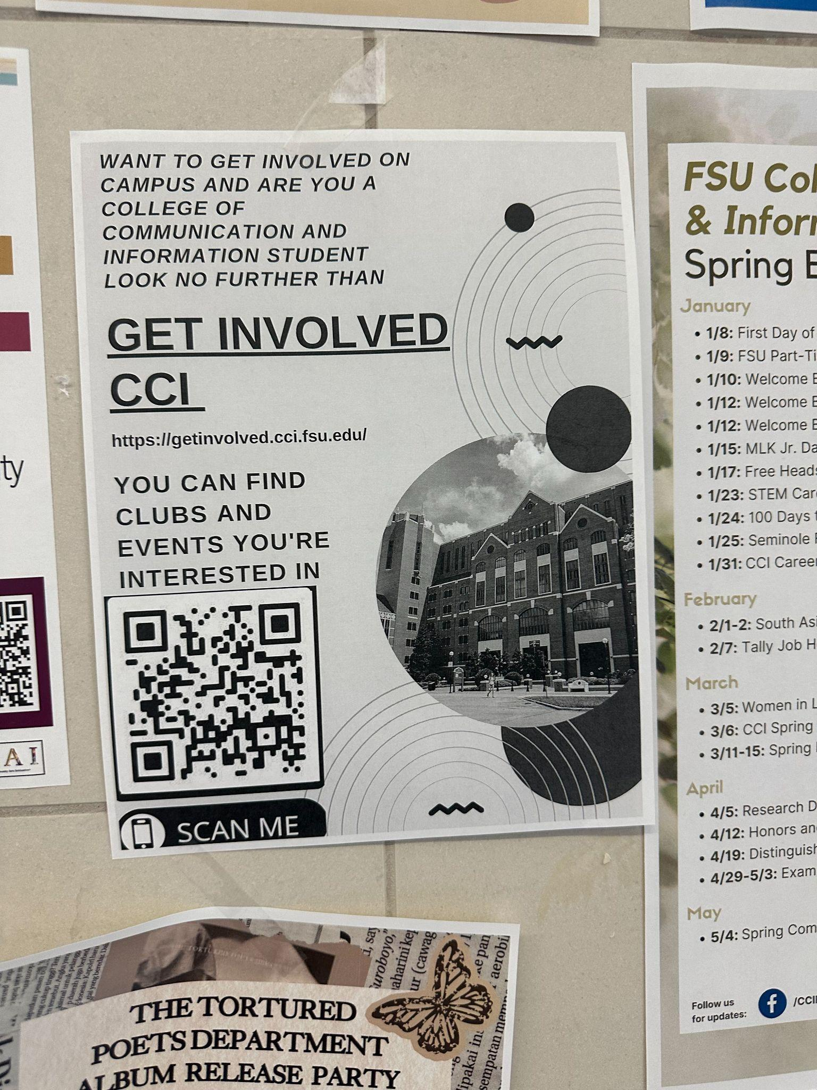
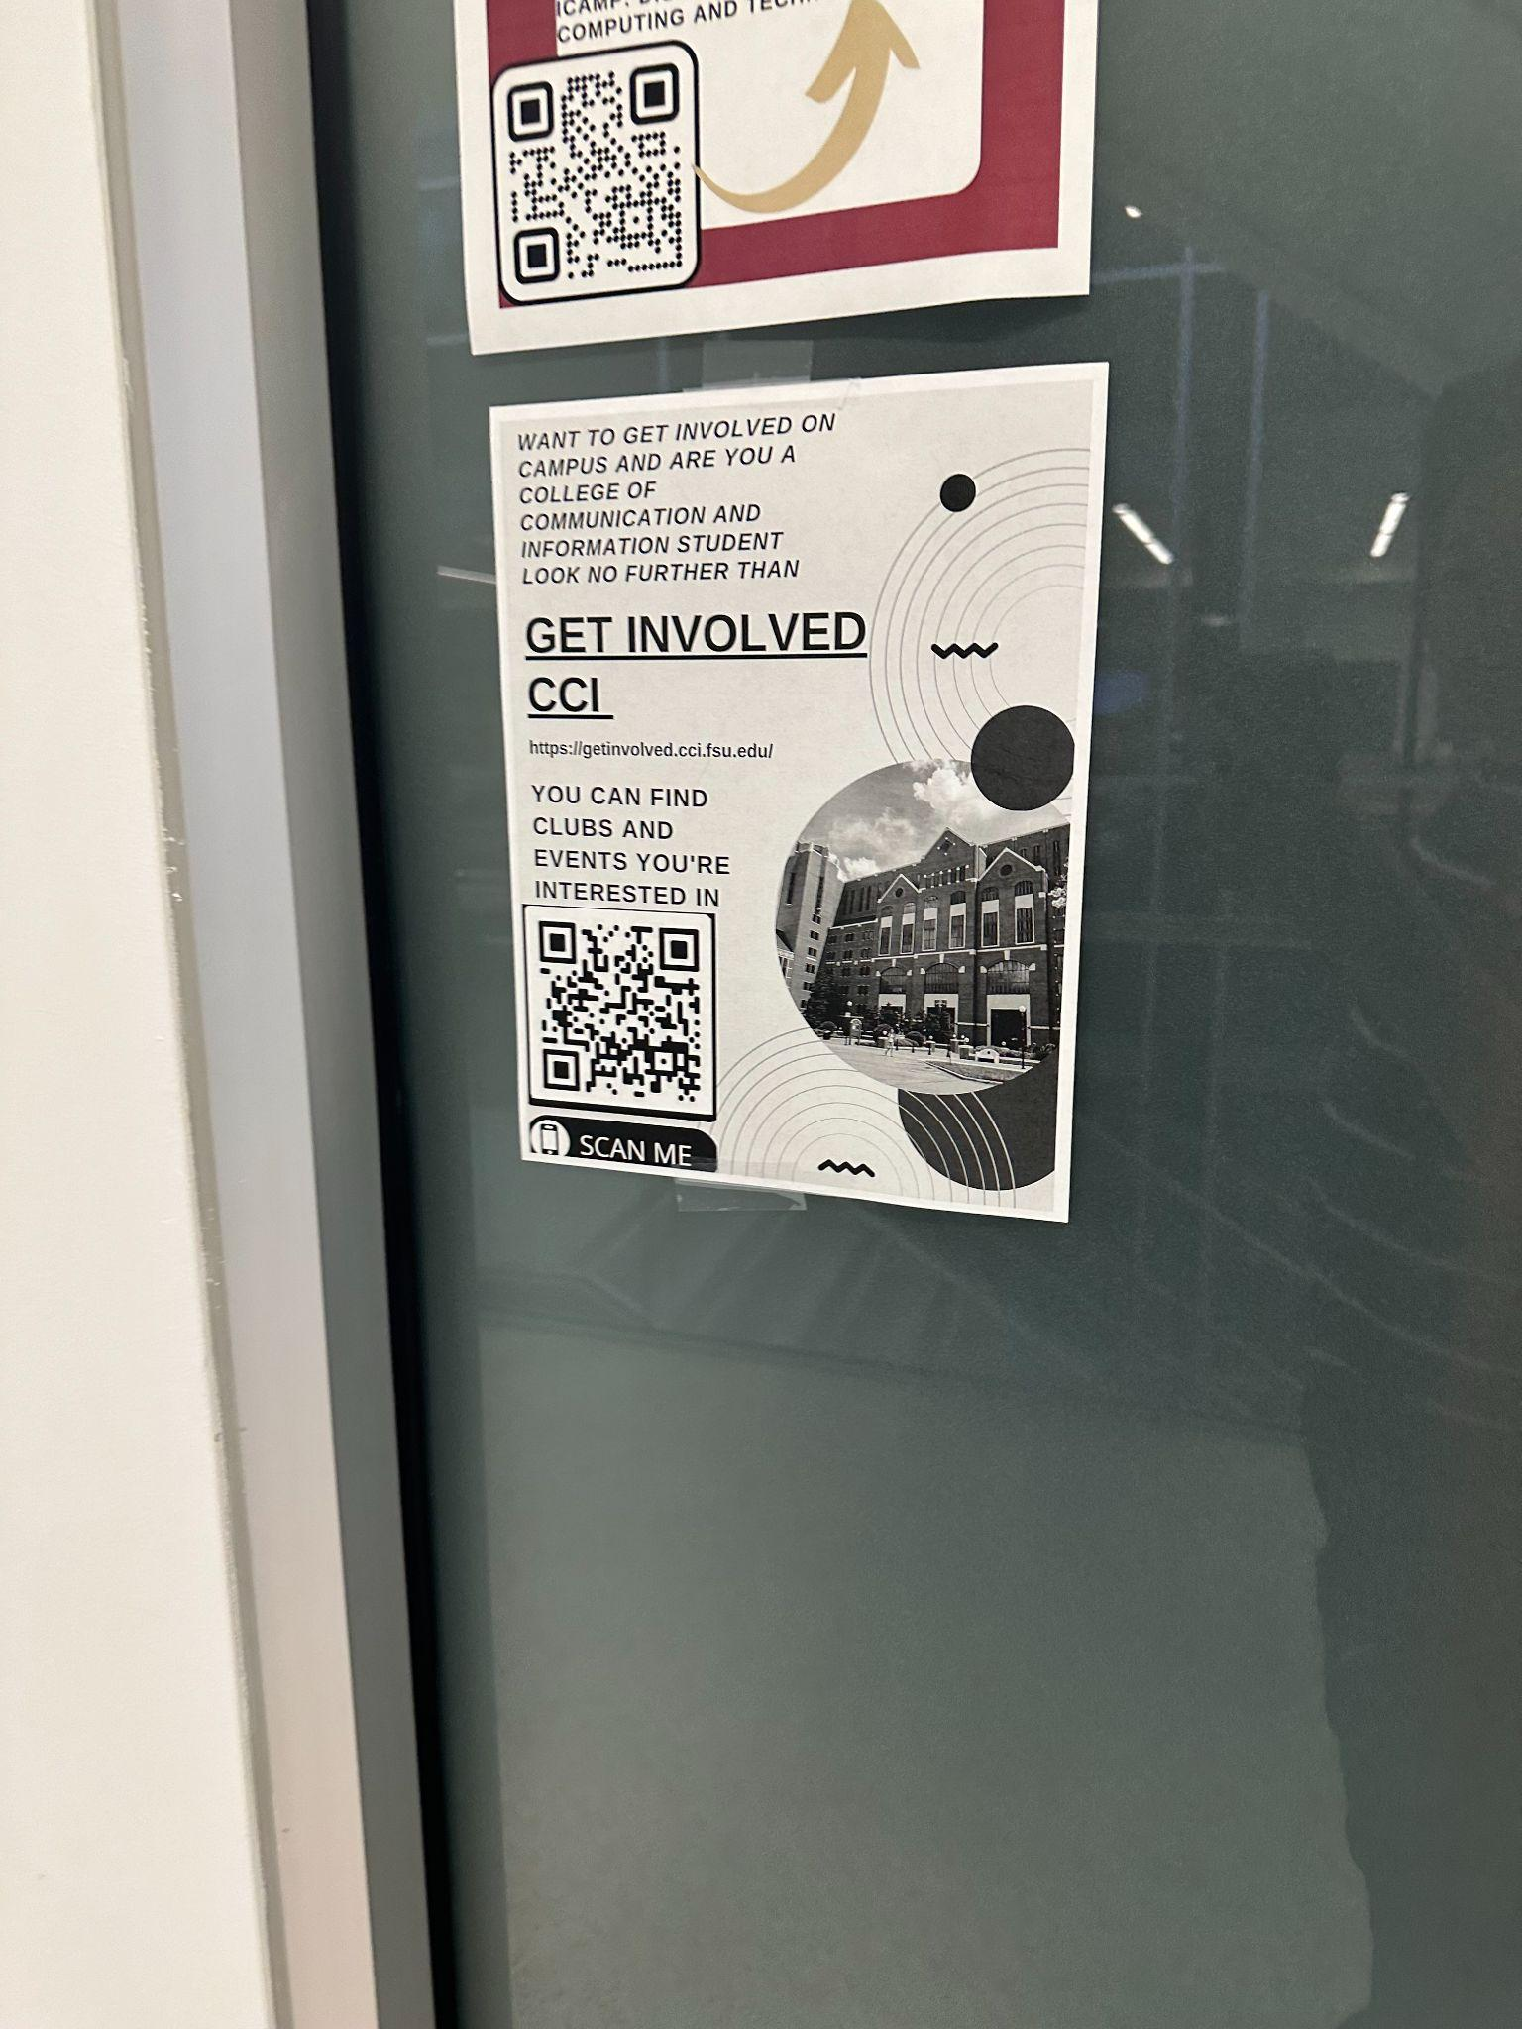
Results to Share
Picture goes HERE
Summary of Achievements:
Exceptional Growth: Increased website traffic by approximately 42%.
Successful Promotion: Distributed flyers widely across campus, exceeding initial metrics.
Key Learnings:
Collaborative Success: The synergy between team members significantly amplified our promotional efforts.
Effective Strategy: Direct engagement through flyers and digital outreach proved highly effective in increasing student involvement.
Acknowledgments:
Special Thanks: To all team members for their dedication and innovative contributions.
Appreciation: To our faculty advisors and administrative supporters for their guidance.
Recommendations for Future Groups:
Sustain Engagement: Continuously update content and engage with users to maintain and grow website traffic.
Expand Reach: Explore additional promotional channels such as social media and campus events.
Picture goes HERE

